Slide 1


Nashville Data Crime Analysis
Yang Liu, Tolly Smith
Justin Roth, Bill Schreiber

Slide 2
Core message
We wanted to find some crime trends in Nashville for the year 2016 using data of calls placed for police service to help our city be a safer place to live.

Slide 3
Questions Asked
What Police tencodes are used the most often?
What parts of Davidson County see a higher number of calls received?
What hours of the day receive the most number of police calls?
Have certain crimes of interest increased or decreased over time?

Slide 4
Why we asked these questions
Advice to the Metro Nashville Police department
Overview of when and where crimes are occurring
Help predict who will commit crimes in the future
Determine areas of Nashville that require more police presence to deter crime from occurring

Slide 5
Were these questions answered to our satisfaction?
Summary of tencode descriptions
Latitude and longitude coordinates with Gmaps
Group every call into each hour of the day
Group crimes into each month

Slide 6
How we answered our questions
Our data was pulled from Data.Nashville.gov.
Emergency and non-emergency numbers
Over 20 million pieces of data
1.13 Million rows x 19 columns
Every row was a different call requesting police assistance

Slide 7
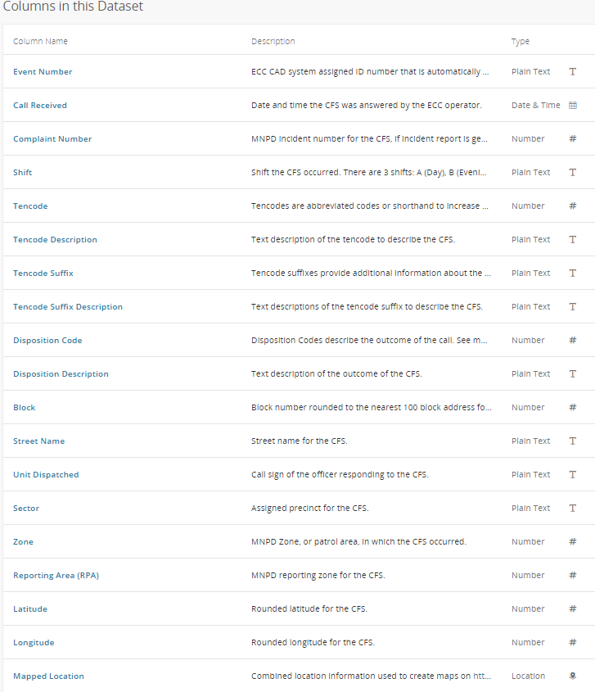
Columns in the Dataset

Slide 8
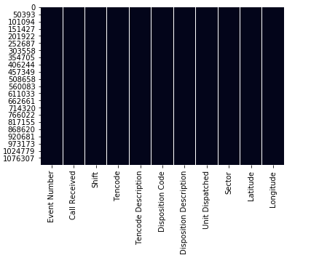
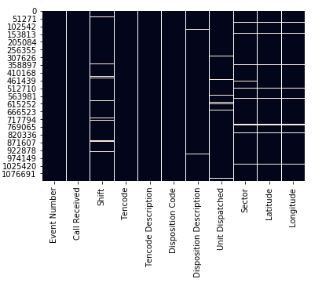
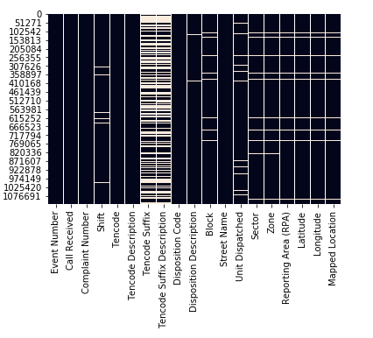
Data Cleanup and Exploration
With over 1 million calls over the course of the year, we expected to have some null values. Tencode Suffix and Tencode Suffix Description had many null values. These columns were dropped. We dropped all other rows with any null data.

Slide 9
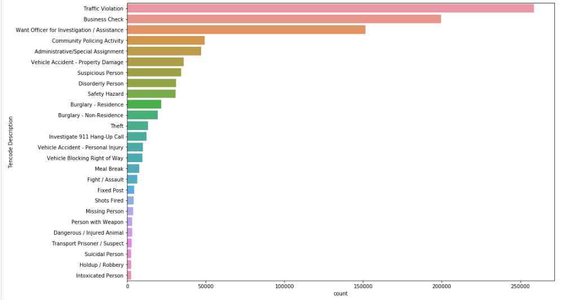
Data Cleanup and Exploration
973,598 rows and 11 columns of complete data.
However, when looking at value counts of tencode descriptions, we found that the most common calls were not crime, but required police assistance.

Slide 10

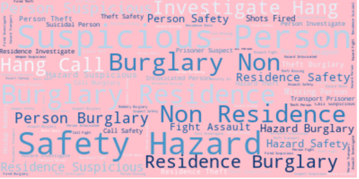
Data Cleanup and Exploration
Drop Tencodes that were not real crime

Slide 11
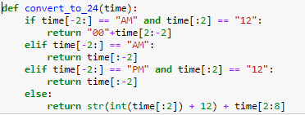
Data Cleanup and Exploration
Sort data by time , day of the week, and month of year.
Our time column showed AM/PM. For easier analysis we used a formula to convert all times to military time or 24 hour time.

Slide 12
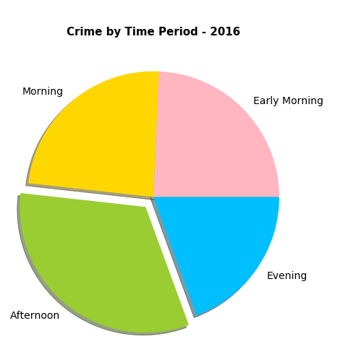
Data Cleanup and Exploration
Using the time column, we created bins for “Early Morning”, “Morning”, “Afternoon”, and “Evening

Slide 13
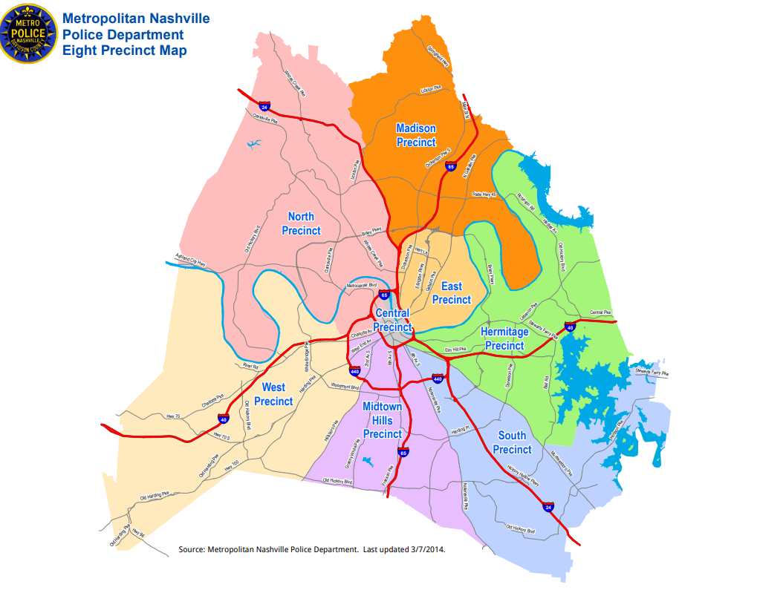
Data Analysis
To begin our analysis we needed to become familiar with each of the 8 Metro Nashville police precincts
Central
East
Hermitage
Madison
Midtown Hills
North
South
West

Slide 14
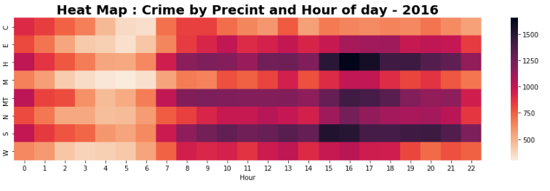
Heatmap of frequency of crimes in each precinct by hour of the day
Fewest number of calls between 4am and 6am
Highest number of calls between 3pm and 5pm
Precinct

Slide 15
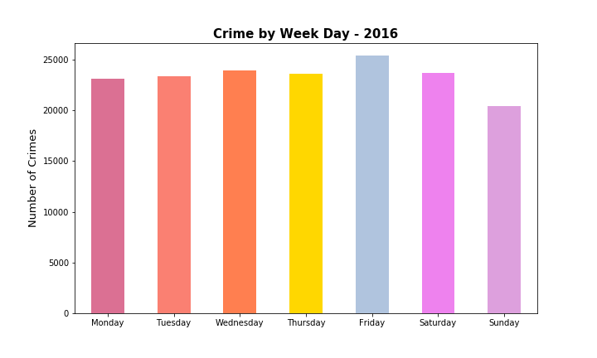
Crime by Day of the Week

Slide 16
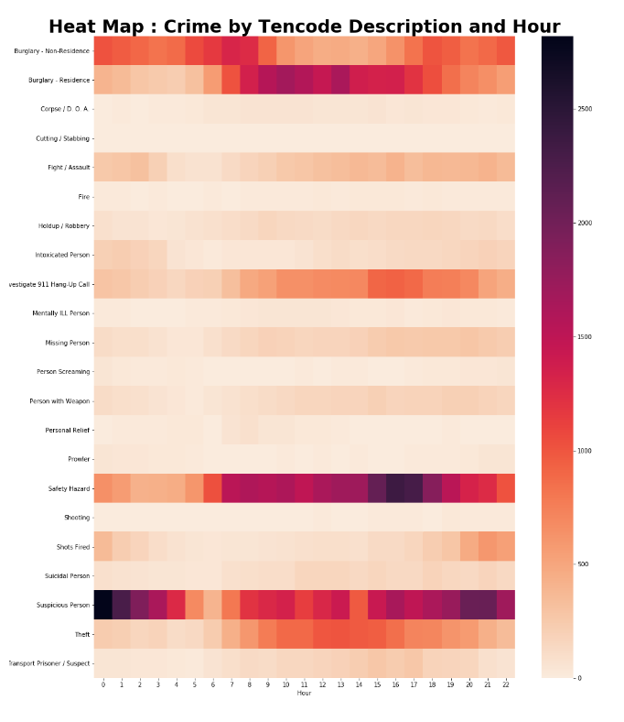
Heatmap of tencode description by hour of the day
Highest number of calls for residential burglaries are between 10 am and 2pm
Highesty number of calls for suspicious person are between 10pm and 2am
Highest number of calls for safety hazard are between 3pm and 6pm

Slide 17
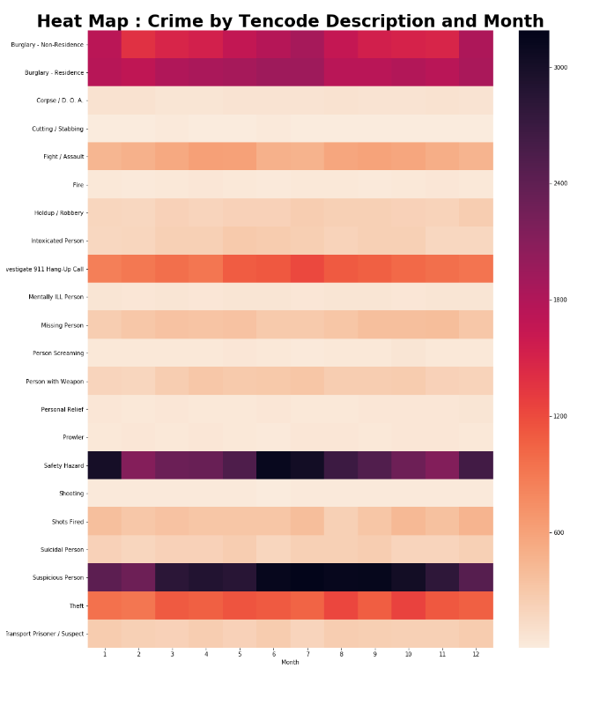
Heatmap of tencode description by month
Number of burglaries was consistent throughout the year
Highesty number of calls for suspicious person are in summer months
Highest number of calls for safety hazard are January, June, July, December

Slide 18
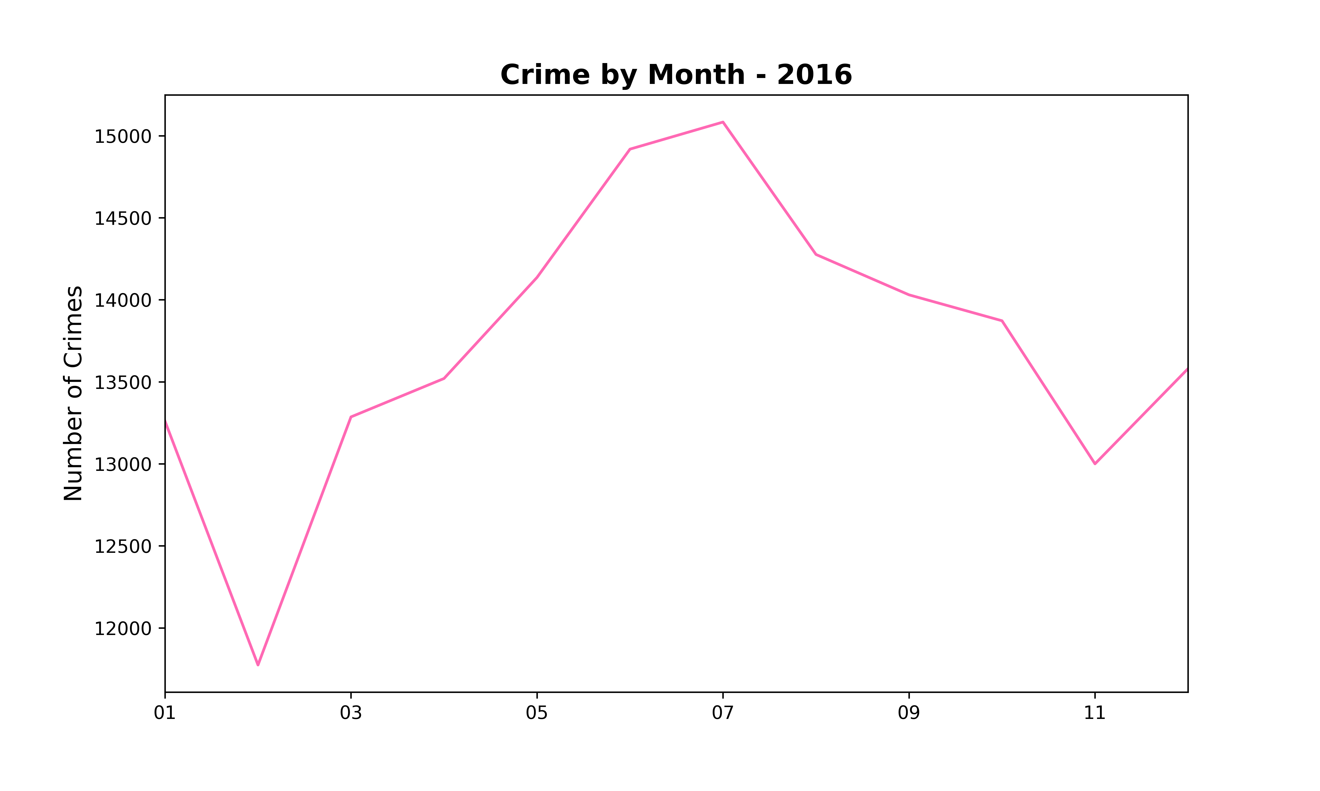
Crime by Month

Slide 19

Highest Frequency of Residential Burglaries
Fewest number of calls between 4am and 6am
Highest number of calls between 10am and 2pm

Slide 20
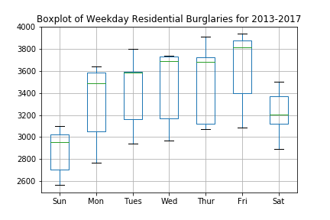
Boxplot of Residential Burglaries 2013-2017

Slide 21
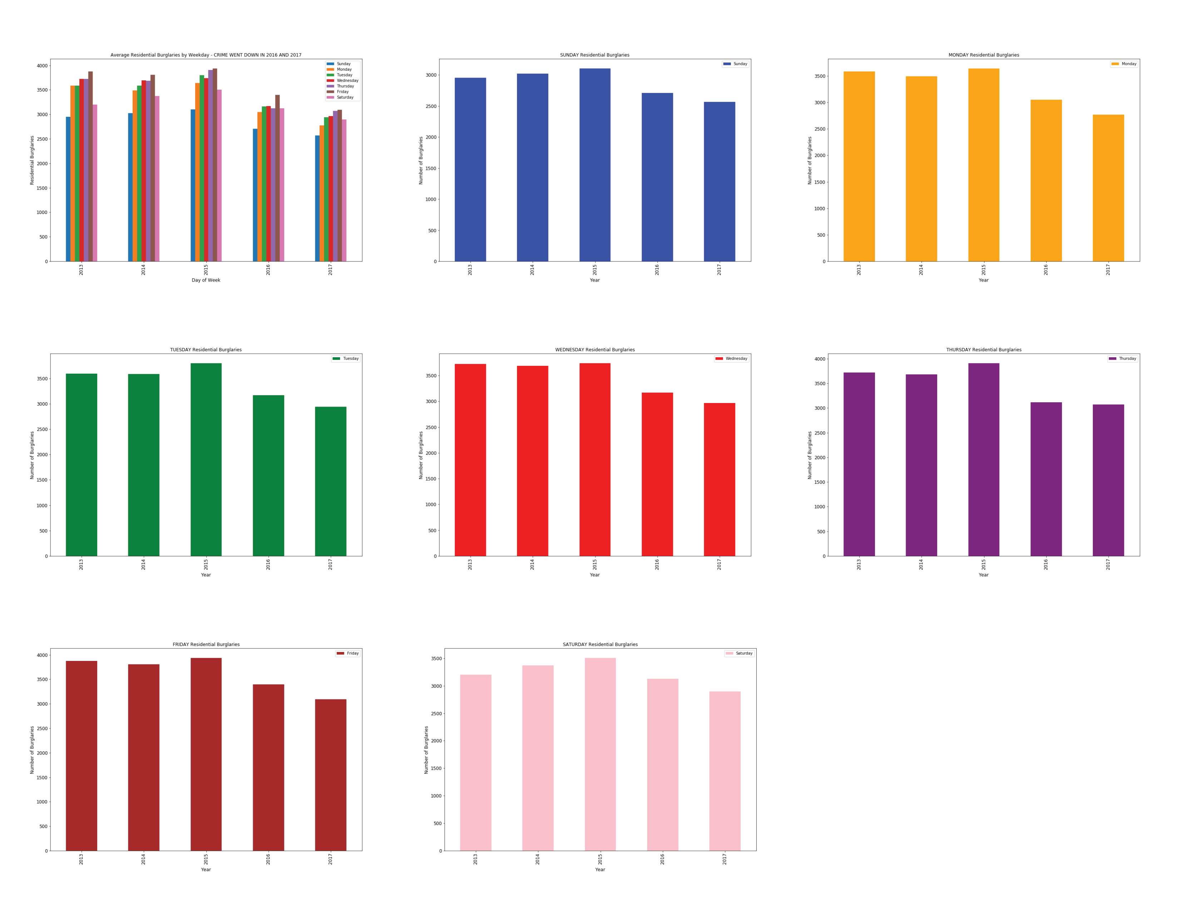
Residential Burglaries 2013-2017 for each day of the week

Slide 22
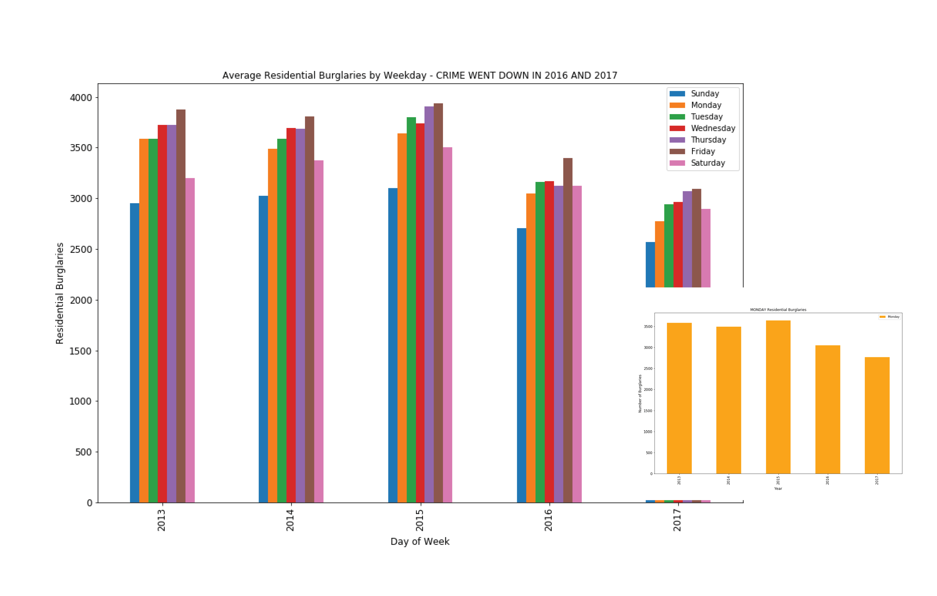
2013-2017
Cumulative Residential Burglaries
Trending down in 2016 and 2017

Slide 23
Stat Tests Analysis
For the statistical analysis, we compared residential burglaries. We compared frequency by day of week. We then compared the numbers across years (2013-2017).
After calculating the mean and standard deviation for each day, we prepared a boxplot.
Sunday looks to have the least amount of crime and Friday appears to be the day with the highest crime. We ran a t-test to confirm. With a value of 0.00627, we reject the null hypothesis that the mean of the crimes on these two days are statistically the same. We accept the alternative hypothesis that the crime on these two days are statistically significant.
We then ran the ANOVA test on the days of the week. With a low P value, 0.03419, we reject the null hypothesis that all days statistically have the same amount of residential burglaries. We accept the alternative hypothesis that the mean of at least one day is significantly different.
In looking at the charts and means, Saturday and Sunday look to have the lowest amount of residential burglaries. For fun, we reran the ANOVA test with weekdays only. This result was 0.74071. With result above 0.05, we accept the null hypothesis that average residential burglary on any weekday is statistically similar to the same crime on any other weekday.
Moral of the story, according to historical data from 2013-2017, if you are going to leave your house unlocked and do not want a break-in, do it on a Sunday!

Slide 24
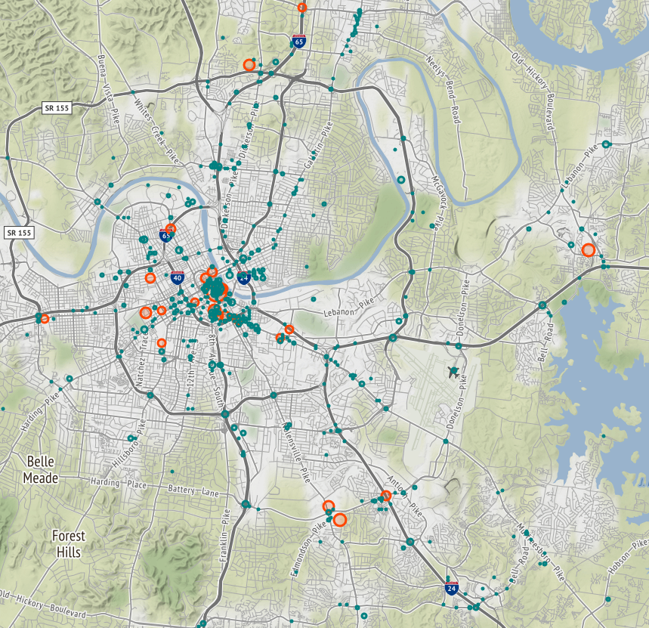
GMaps
Red circle is above 200 real crime
Green dots are approximately 50-199 crimes

Slide 25
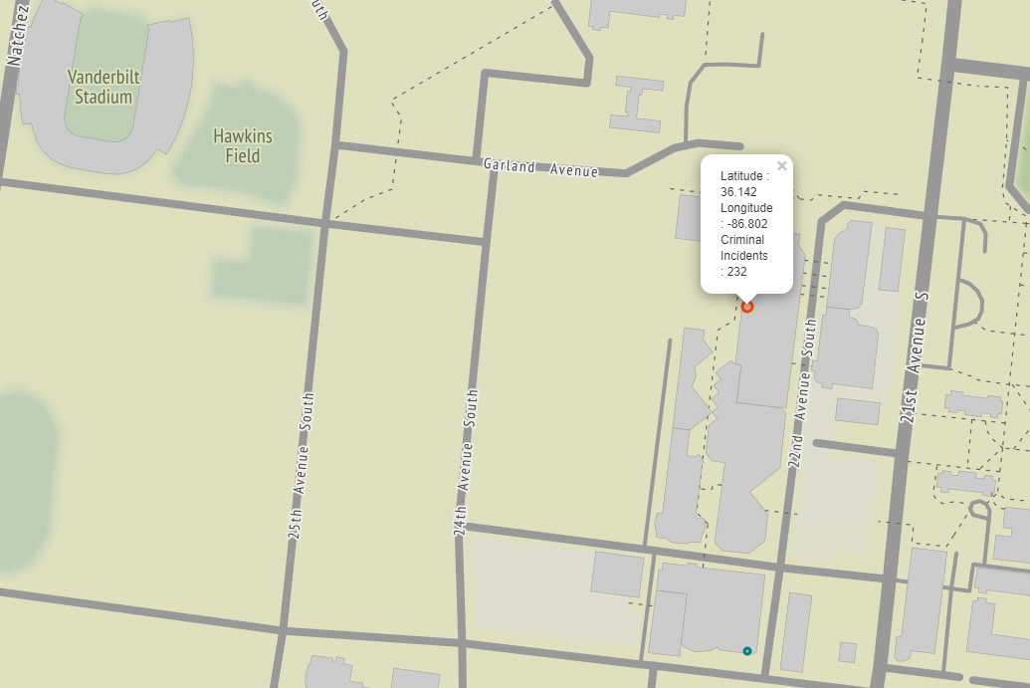
GMaps
Be careful around Vanderbilt campus
232 incidents in close proximity in 2016

Slide 26
Challenges
Downsizing dataframe to the data we found most useful
Merging code into 1 notebook
Binning times in segments of day
Statistical analysis
Finding useful dataset
Syntax

Slide 27
Additional Questions We would ask with 2 more weeks
How does weather affect frequency of crime?
What trends are we seeing in Nashville crime over the last 5 years?
Show plot of crime in relation to median income
Statistical analysis of additional tencodes
Statistical analysis for additional cities

Slide 28
Questions

